Slide 1
Coffee shop Clustering
By: Dimitar Kumenov 22.11.2019

Slide 2
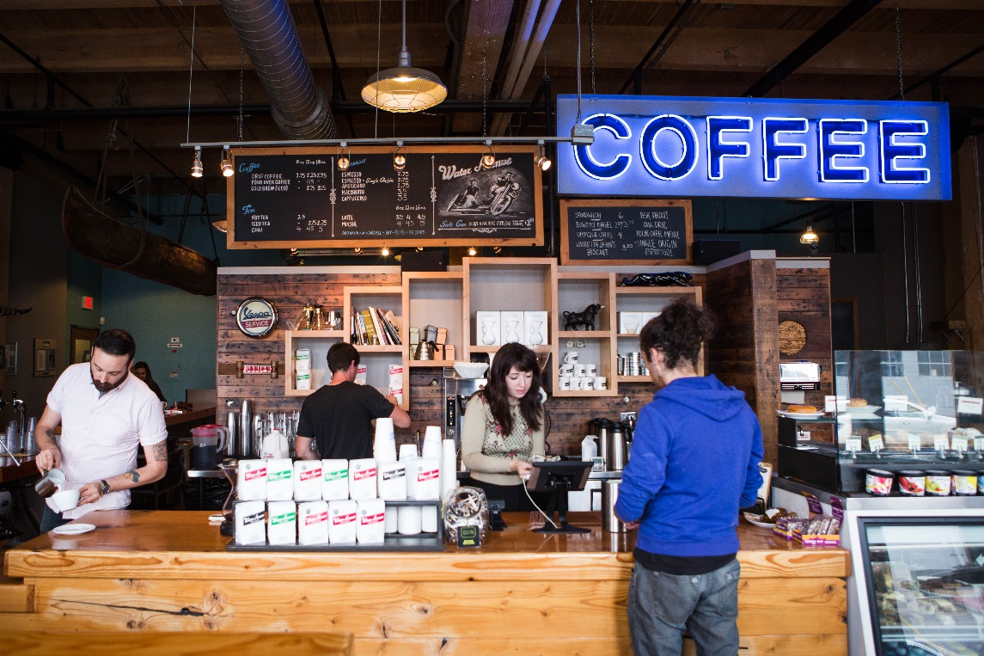
DEFNITION OF THE Problem
A business owner wants to open a new coffee shop in San Francisco.
He wants to be recommended which is the most suitable neighborhood.

Slide 3
SOLUTION
The proposed solution is to gather the needed data about neighborhoods in the city and the data about all coffee shops in them. After this we will cluster the neighborhoods and we will chose the best one based on a criteria.

Slide 4
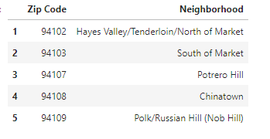
Web scraping data about neighborhoods
Web page : http://www.healthysf.org/bdi/outcomes/zipmap.htm
Look of the data

Slide 5
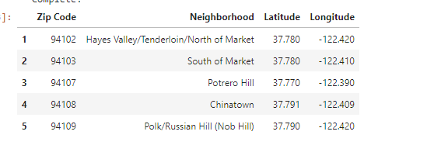
Adding geo coordinates

Slide 6
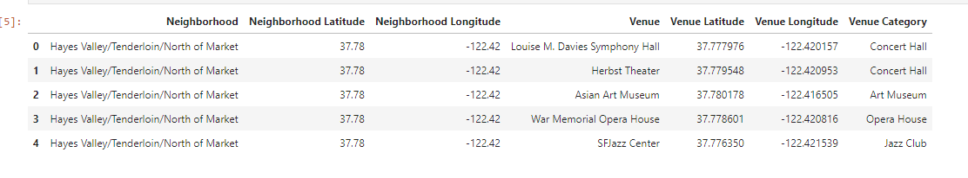
Get coffee shops data from foursquare

Slide 7
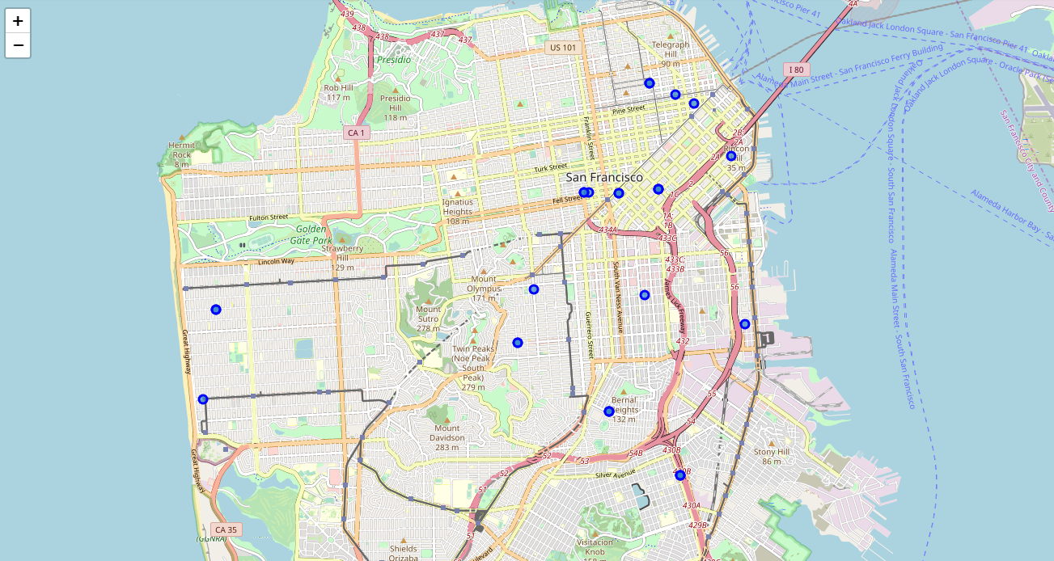
Plotting the neighborhoods which have coffe shops

Slide 8
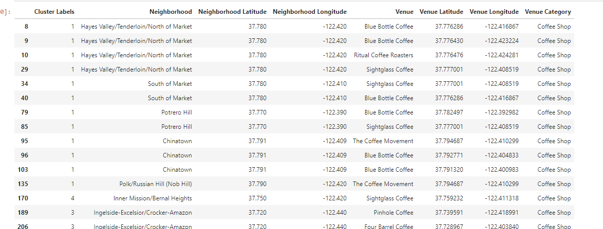
Clustering the neighborhoods.

Slide 9
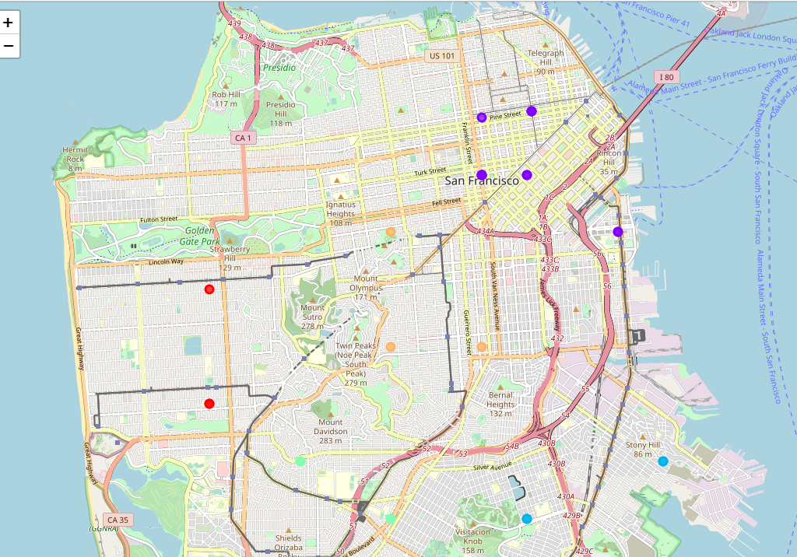
Map clustered neighborhoods

Slide 10
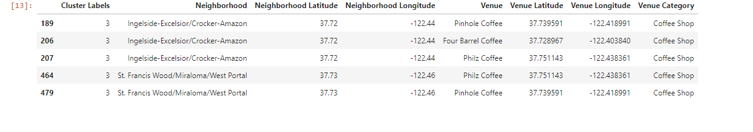
Conclusion
We choose the cluster 3 from which will be recommended a neighborhood for the new coffee shop .

